Slide 1
APPLICATIONS OF PERSONALITY PSYCHOLOGY TO MARKET RESEARCH
CHRIS HARVEY
12TH MAY 2022

Slide 2
ACTIVATE RESEARCH – BRIEF SUMMARY
We inspire change and drive growth through enabling a deeper understanding of how people think and why they behave as they do
We add complementary insights and approaches from behavioural science (and psychology more broadly) to agencies’ research offer
This enables end clients to better understand, predict and influence target audience behaviour

Slide 3
AGENDA
1. WHY PSYCHOLOGY?
2. WHY PERSONALITY?
3. COMMON TESTS AND MODELS
4. FOUR WAYS TO ENHANCE MR STUDIES
5. WRAP-UP AND Q&A

Slide 4
1. WHY PSYCHOLOGY?

Slide 5
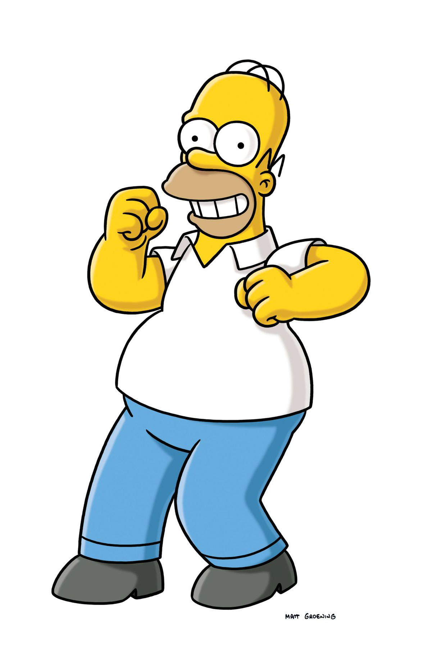
WHY PSYCHOLOGY?
“Far from homo economicus, we often seem closer to Homer (Simpson) economicus”
Behavioural Economics: The Basics (Philip Corr & Anke Plagnol)

Slide 6
COGNITIVE BIASES
Status quo bias
Unconscious bias
Over-confidence
Authority bias
Availability bias

Slide 7
TWO CHALLENGES
Understanding of current and / or future behaviour may be inaccurate
Reporting of current and / or future behaviour may be dishonest

Slide 8
2. WHY PERSONALITY?

Slide 9
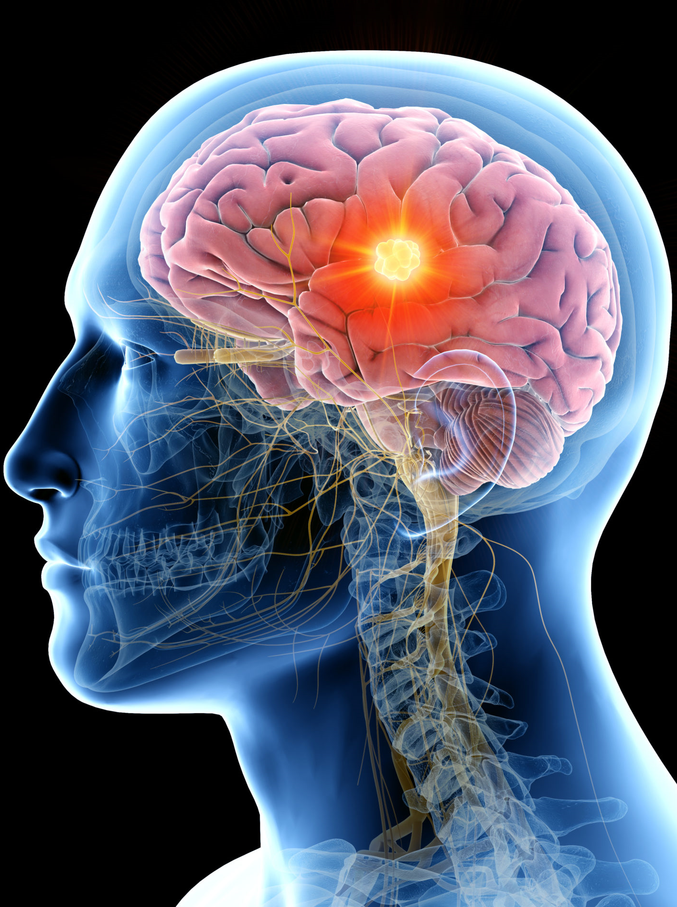
WHAT IS PERSONALITY?
Personality is the general tendency to behave consistently across situations
Personalities are distinct, and stable over time

Slide 10
PERSONALITY PREDICTS BEHAVIOUR
“Very brief measures of young adults’ personalities predicted their midlife physical health across multiple domains”
Translating Personality Psychology To Help Personalize Preventive Medicine for Young-Adult Patients https://www.ncbi.nlm.nih.gov/pmc/articles/PMC3951727/

Slide 11
PERSONALITY PREDICTS BEHAVIOUR
Studies have established higher neuroticism among females
https://www.greenbook.org/mr/market-research-news/3-variations-in-covid-19-vaccine-uptake-which-can-be-explained-by-personality-differences/

Slide 12
PERSONALITY CAN ALSO BE USED TO INFLUENCE BEHAVIOUR
“Adapting persuasive messages to the personality traits of the target audience can be an effective way of increasing the messages’ impact”
Personalized Persuasion: Tailoring Persuasive Appeals To Recipients’ Personality Traits https://journals.sagepub.com/doi/10.1177/0956797611436349

Slide 13
3. COMMON TESTS AND MODELS

Slide 14
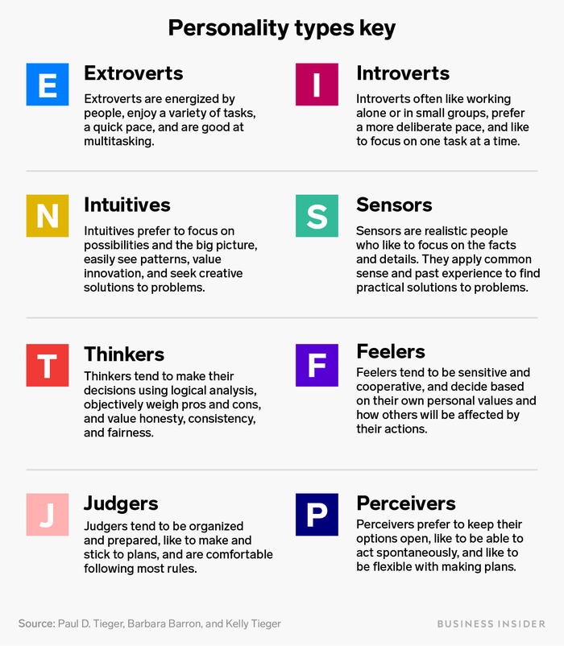
MYERS-BRIGGS
”Make the theory of psychological types described by C.J. Jung understandable and useful in people’s lives”
Around 2m people per year – and 89 of the Fortune 100

Slide 15
MYERS-BRIGGS: KEY CRITICISMS
Low predictive power
Low replicability
No controlled experiments or data (made up on own experiences)
Binary assumption
https://www.vox.com/2014/7/15/5881947/myers-briggs-personality-test-meaningless
“Every individual is an exception to the rule” (Jung)

Slide 16
OCEAN / BIG FIVE – SUMMARY
LOW
HIGH
Spectrum
Effectively predicts behaviour
Stable in short and medium term
Strong genetic basis
People provide the information honestly
High reliability
Openness to experience
(Inventive/curious vs consistent/cautious)
Conscientiousness
(Efficient/organised vs easy-going/careless)
Extraversion
(Outgoing/energetic vs solitary/reserved)
Agreeableness
(Friendly/compassionate vs cold/unkind)
Neuroticism
(Sensitive/nervous vs secure/confident)
An introduction to the five-factor model and its applications
https://psycnet.apa.org/record/1993-01496-001

Slide 17
TRAITS AND FACETS
Openness to experience
Imagination
Artistic
Emotionality
Adventurous
Intellect
Liberalism
Conscientiousness
Self-efficacy
Orderliness
Dutifulness
Achievement
Self-discipline
Cautiousness
Extraversion
Friendliness
Gregarious
Assertive
Activity
Excitement
Cheerfulness
Agreeableness
Trust
Morality
Altruism
Cooperation
Modesty
Sympathy
Neuroticism
Anxiety
Anger
Depression
Self-conscious
Immoderation
Vulnerability
A very brief measure of the big five personality domains
https://psycnet.apa.org/record/2003-09807-003

Slide 18
EXAMPLE STATEMENTS
EMOTIONALITY
(OPENNESS TO EXPERIENCE)
SYMPATHY
(AGREEABLENESS)
I experience my emotions intensely
I don’t understand people who get emotional
I feel sympathy for those worse off than myself
I am not interested in other people’s problems

Slide 19
4. FOUR WAYS TO ENHANCE MR STUDIES

Slide 20
FOUR WAYS TO ENHANCE MR STUDIES
Improving understanding without collecting personality data
Understanding, predicting, and influencing behaviour through collecting personality data
Enhancing qualitative recruitment
Understanding brands as personalities

Slide 21
1. IMPROVING UNDERSTANDING WITHOUT COLLECTING PERSONALITY DATA
Studies have established higher neuroticism in females
Source: https://www.england.nhs.uk/statistics/statistical-work-areas/covid-19-vaccinations/

Slide 22
1. IMPROVING UNDERSTANDING WITHOUT COLLECTING PERSONALITY DATA
Females’ significantly greater likelihood to be agreeable may cause them to be more likely than males to overstate their interest in a new concept being tested in research
Male patients’ overall lower modesty may result in them being more likely to under-estimate future compliance challenges
Sex differences in 30 facets of the five factor model of personality in the large public (N = 320,128)
https://psycnet.apa.org/record/2018-16054-025

Slide 23
1. IMPROVING UNDERSTANDING WITHOUT COLLECTING PERSONALITY DATA
Self-report measures have established higher neuroticism and agreeableness in women across 55 cultures
Why Can´t a Man Be More like a Woman? Sex Differences in Big Five Personality Traits Across 55 Cultures
https://www.researchgate.net/publication/24001221_Why_Can't_a_Man_Be_More_Like_a_Woman_Sex_Differences_in_Big_Five_Personality_Traits_Across_55_Cultures_vol_94_pg_168_2008

Slide 24
2. Understanding, PREDICTING, and influencing BEHAVIOUR THROUGH COLLECTING PERSONALITY DATA
ANTICIPATED REGRET
A meta-analysis on medical treatments found anticipated regret to be a better predictor of behaviour than evaluations of risk
Anticipated regret and health behavior: A meta-analysis
https://pubmed.ncbi.nlm.nih.gov/27607136/

Slide 25
2. Understanding, PREDICTING, and influencing BEHAVIOUR THROUGH COLLECTING PERSONALITY DATA
ANTICIPATED REGRET
Whenever I make a choice, I try to get information about how the other alternative turned out
Whenever I make a choice, I’m curious about what would have happened if I had chosen differently
Maximizing Vs Satisficing: Happiness is a matter of choice https://www.researchgate.net/publication/11048743_Maximizing_Versus_Satisficing_Happiness_Is_a_Matter_of_Choice

Slide 26
2. Understanding, PREDICTING, and influencing BEHAVIOUR THROUGH COLLECTING PERSONALITY DATA
Allows us to understand our target audience and see what the biggest behavioural drivers and barriers are
Quantitatively:
KDA: Correlate with behaviour or intended behaviour
Segmentations: traits only OR combined with other
Qualitatively can probe more and get deeper understanding through examples

Slide 27
3. ENHANCING QUALITATIVE RECRUITMENT
One approach is to tailor recruitment towards the most suitable personality traits for a project, e.g. for concept development research, over-recruit those high on imagination
Alternatively, use insight of how traits differ by group, e.g. females are more able to be sympathetic than males, so are better when helping to understand how to communicate with vulnerable groups
Sex differences in 30 facets of the five factor model of personality in the large public (N = 320,128)
https://psycnet.apa.org/record/2018-16054-025

Slide 28
4. UNDERSTANDING BRANDS AS PERSONALITIES
Considering personalities of brands can help facilitate product differentiation and create meaningful relationships
Research has consistently shown that consumers do not have any difﬁculty in describing their brands in terms of human characteristics
Research also shows that corporate personality predicts some important financial indicators, including profitability, growth, and share performance
Dimensions of brand personality
https://www.jstor.org/stable/3151897

Slide 29
5. WRAP-UP AND Q&A

Slide 30
WRAP-UP
What, why, common tests and models, MR applications
Consider when want to understand, predict, or influence behaviour in trickier situations
Combine with other things (demos, needs etc) – NOT replace

Slide 31
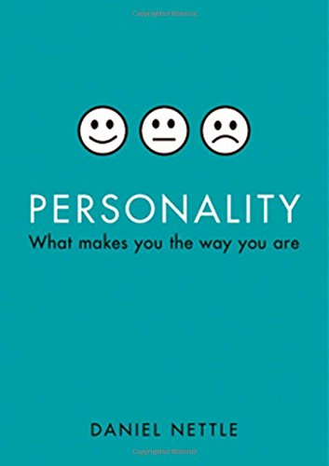
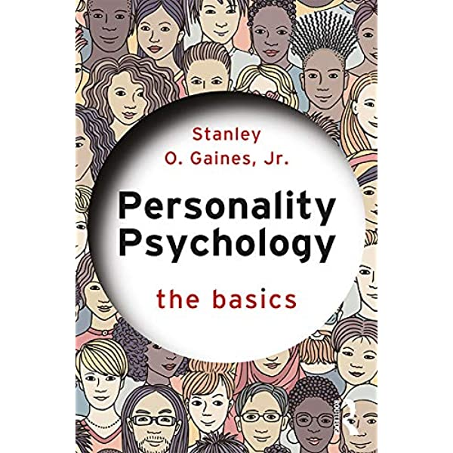
Suggested further reading

Slide 32
THANK YOU! E: CHRIS.Harvey@activate-research.com M: +44 (0) 7816 015772

Slide 33
RESOURCES (NEW SLIDE)
Repository of 186 different measures (mainly health related)
Simplest possible 10-item personality inventory
One of many tests to uncover your own personality (this is short but quite rigorous; use access code 57562353 to take it)
Upcoming Activate Research short book: “A 4-part guide to changing behaviour using the ACE-M model” – contact chris.harvey@activate-research.com to order a FREE copy

