Slide 1
Notes:
Good morning everyone, and welcome to the ICG’s Digital Academy webinar series.
I’m Sally Alsop, the ICG committee member responsible for the ICG webinar programme.

Slide 2
Webinar:
Disability: Breaking Down the Barriers
With Steven Lacey
Notes:
For today’s webinar we are delighted to welcome ICG member and owner of The Outsiders, Steven Lacey.
Steve is an ex-strategist and an award-winning qualitative researcher. He is both disabled and neurodiverse and conducts lots of research in the diversity space. I should add that Steve hides his light under a bushel somewhat, as a quick review of his ICG profile shows he was winner of the MRS Best Cultural Insight award in 2022, the MRS Best Creative Development research award in 2022, the MRS Best International Research Award in 2021 and the MRS Bravery Award in 2016. And if you have 5’ to spare, take a look at the Outsiders website and run the intro film with the sound on! A very powerful sales pitch!
In this ICG webinar, Steve will tell us about his own life and personal challenges and then he will talk more generally about the lives of those with disabilities, the barriers they face, and what brands can do to support them. He will also be sharing some tips on the best ways to conduct research, how to represent people with disabilities in marketing, and how to create good innovation.
Steve is happy to take any questions both after the first part of his presentation and at the end, so if you would like to ask something, please turn on your webcam and raise your hand, or type your comments/questions in the chat box.

Slide 3
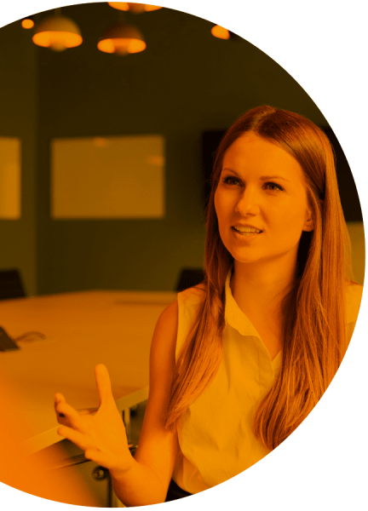
McGowan Transcriptions Professional High-Quality Audio & Video Transcriptions
McGowan Transcriptions has been a leading digital transcription agency in the UK since 1993, specialising in providing accurate and confidential multiple-voice transcriptions to various industries, including market research, medical, and legal sectors. Our services prioritise quality control and security, which is especially crucial in fields where accuracy and confidentiality are essential for research and analysis purposes.
99%+ accuracy guaranteed
Fast-track service from 4 hours
Humans only – NO automation
Dedicated team of professional UK transcribers
Members of AQR and MRS
GDPR and Cyber Essentials Compliant
Get it right first time, every time
T: Free Phone (UK): 0800 158 3733
E: office@mcgowantranscriptions.co.uk
Notes:
This webinar is generously sponsored by McGowan Transcriptions, a leading digital transcription agency in the UK since 1993. They specialise in providing accurate and confidential multiple-voice transcriptions to various industries, including the market research, medical, and legal sectors.
Their services prioritise quality control and security, which is especially crucial in fields where accuracy and confidentiality are essential for research and analysis purposes.

Slide 4
Future Events
Thurs 25th May, 11am
Thurs 8th June, 11am
Weds 14th June, 1pm
Thurs 22nd June, 11am
Thurs 6th July, 6pm
Thurs 13th July, 11am
Weds 26th July, 11am
To AI or Not to AI: Is This The Question?
How do Qual Researchers Feel About Generative AI
Lunch&Learn: Exploring the AI Driven Capabilities of Qualzy
Designing & Facilitating Hybrid Events – A taster
ICG Summer Party
Researching Through The Generations
Five Ways to Grow Profit
Notes:
Before I hand over to Steve, here are some more events we have planned for you over the next few weeks.
Don’t forget that we are able to offer great value sponsorship opportunities with each of our webinars and online events.
Please contact Lucie if you would like to know more.

Slide 5
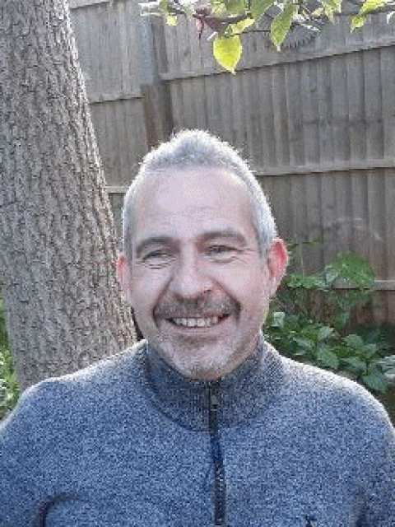
Our speaker:
Steven Lacey
Of
The Outsiders
Notes:
So, now I’ll hand over to Steve…

Slide 6
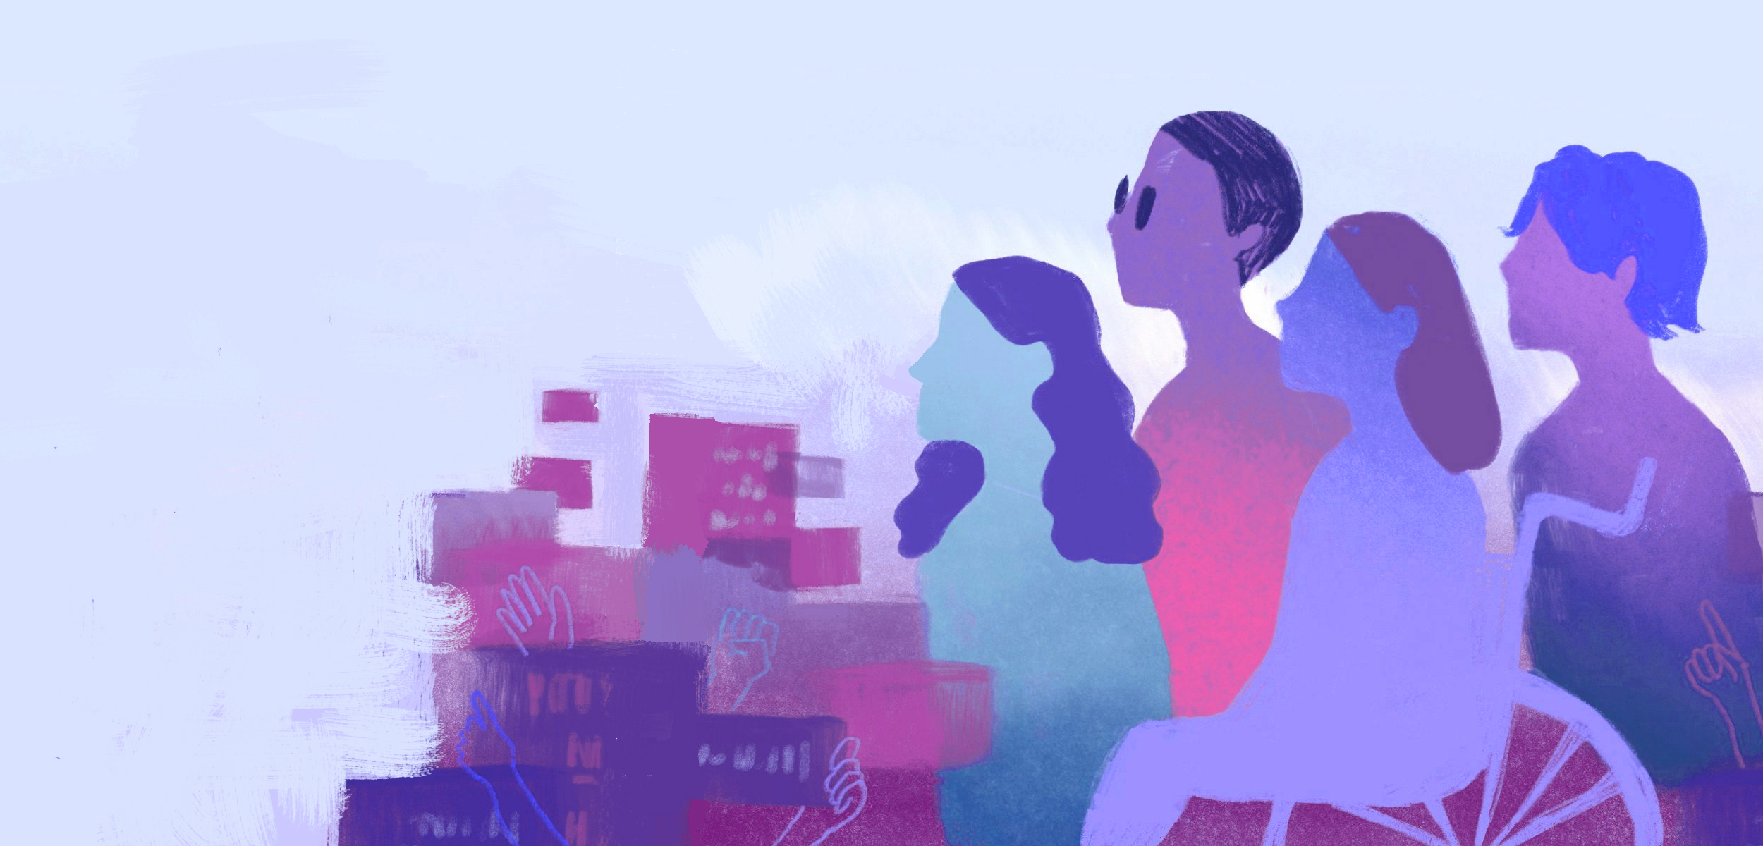
Disability and Neurodiversity

Slide 7
1. A bit about me

Slide 8
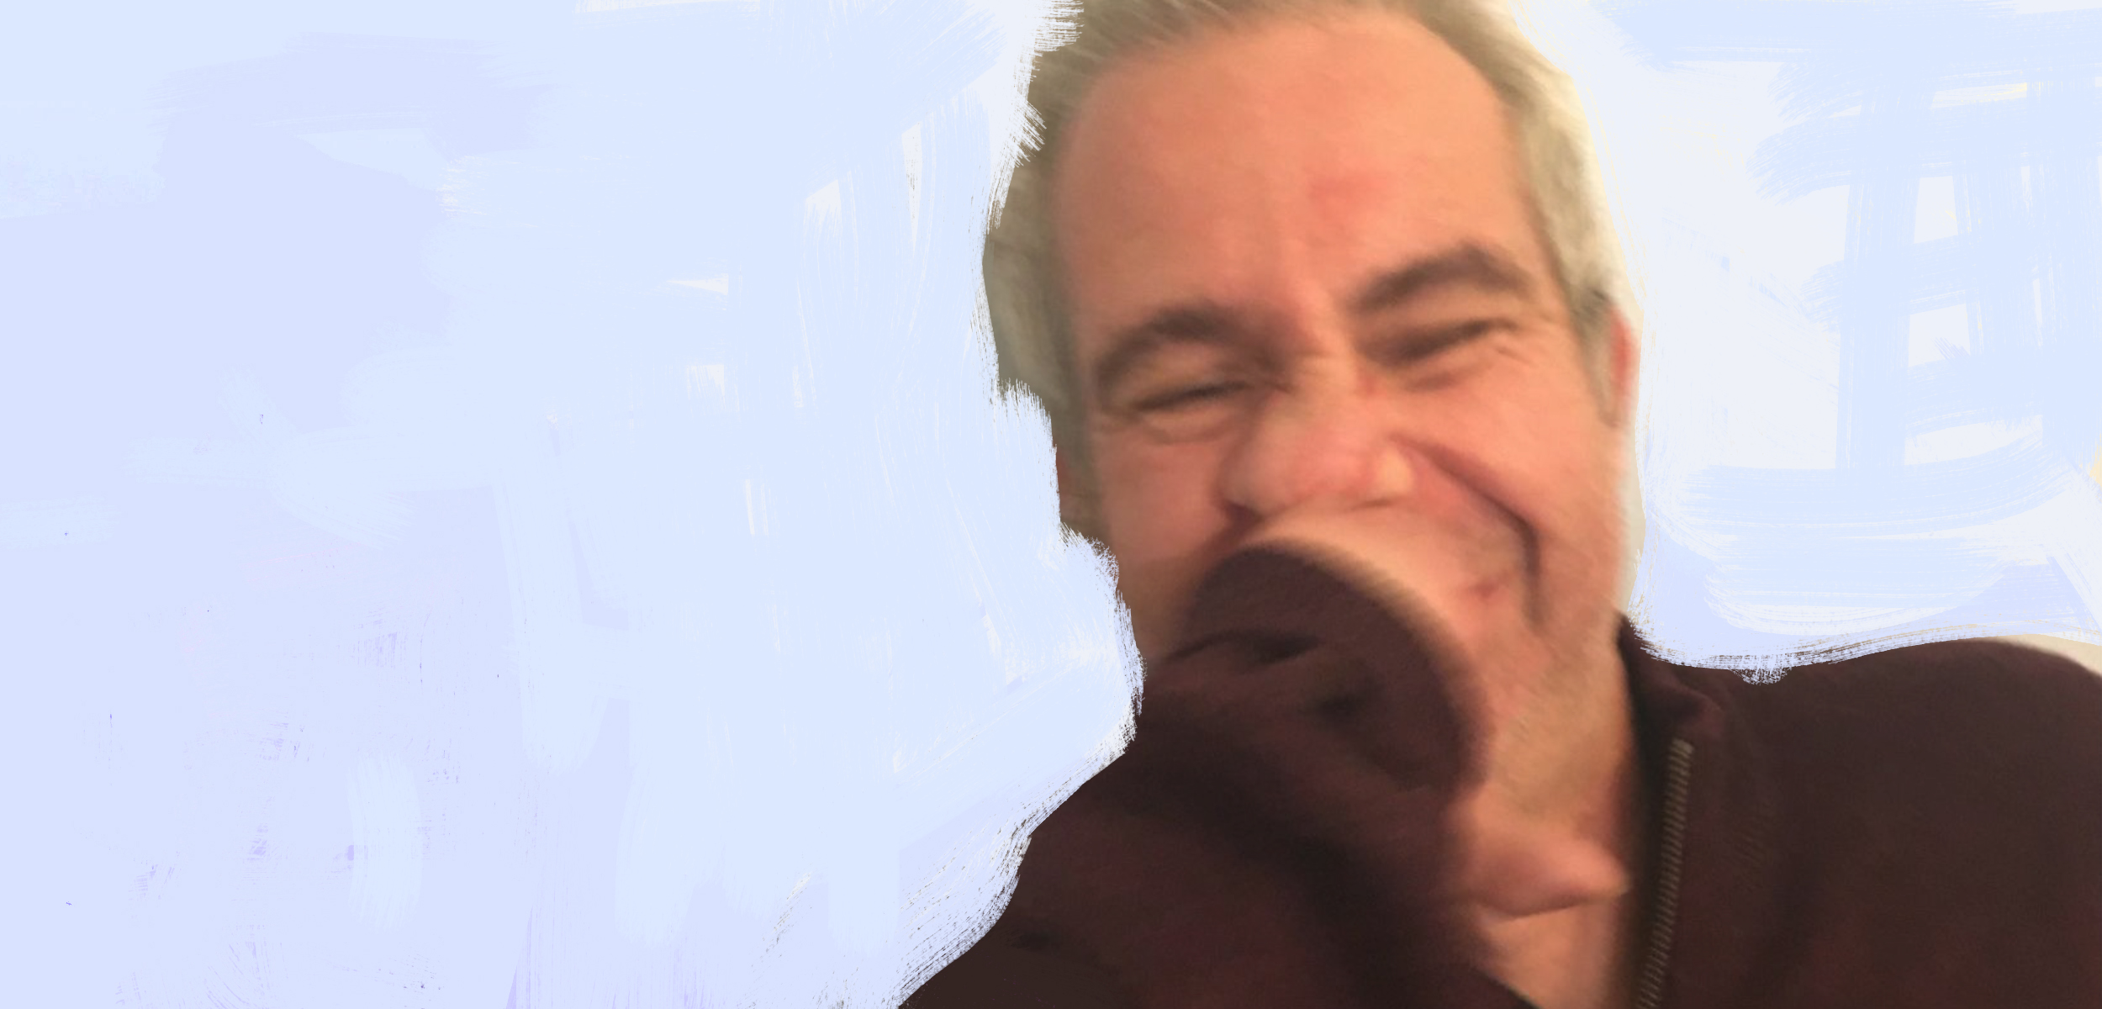

Slide 9
Some of my views (only mine)
People often say ‘how strong you are’ which is nice but has meant I refuse to show weakness - this led to a breakdown in my 30s
I would go into toxic positivity mode because I didn’t want to be pitied
I get stared at a lot but really notice it until I did diversity training
Children ask ‘what is wrong with you’ – I like this curiosity and once you tell them about disability they are your best friend
Adults will often turn their heads away and not give eye contact if they don’t know me
Some adults will ask me what’s wrong with me? But they are just rude!!
People in shops will often talk to my friends and not me!
Being dyslexic I often felt thick and at times still do - sometimes I think that I am not worthy and that I just blag it!
I would hide my dyslexia and when it was exposed; would be super embarrassed
Disability becomes a central focus in a job interview ‘you can feel it’
I can have sex!
I don’t have opinions on every disability issue!
People would make fun of me which is fine only when I give permission and can give back - coming for you!
If you are disabled you are not an angel I have a dark side like everyone else You don’t need to speak slowly to me
You don’t need to speak slowly to me
Lack of thought is rare but can be upsetting like if I am with someone going to a train station and they walk ahead.
I don’t wake up every morning thinking what disabled thing should I do
Breaking down walls and barriers is fucking exhausting!!!
There is good kindness and crap kindness - just ask
Disability for me is a bright colourful and lovely part of my identity jigsaw but it is just a small square

Slide 10
2. Disability

Slide 11
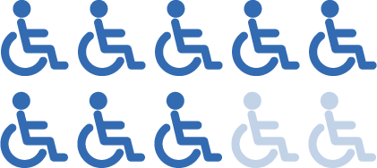
Global stats
Around 15% of the world’s population, or estimated 1.8 billion people, live with disabilities. They are the world’s largest
minority. This figure is
increasing through
population growth, medical advances and the ageing process, says the World Health Organization.¹
1.8 billion
In countries with life expectancies over 70 years, individuals spend on average about 8 years, or 11.5% of their life span, living with disabilities. ¹
8 out of 10 people with a disability weren’t born with it.⁴
1 in 6 of us will be affected by disability. ³
3,300,000,000
75%
More clothes are made for dogs than those with disabilities. ⁶
Their Friends and Family add another 3.3 billion potential consumers who act on their emotional connection to PWD. ²
75% of disabled people have more than one type of impairment. ⁵
Notes:
UN: Factsheet on disability: https://www.un.org/development/desa/disabilities/resources/factsheet-on-persons-with-disabilities.html
2. Design Delight from Disability - 2020 Annual Report by analyst Rich Donovan: The Global Economics of Disability.
3. Leonard Cheshire, https://seable.co.uk/disability-in-the-workplace/#:~:text=Even%20today%2C%20there%20is%20so%20much%20stigma%20around,the%20hardest%20thing%20we%20ever%20have%20to%20face
4. Leonard Cheshire: https://www.linkedin.com/pulse/happy-leonard-cheshire-day-2018-marina-osoba/
5. Sports England: https://sportengland-production-files.s3.eu-west-2.amazonaws.com/s3fs-public/mapping-disability-the-facts.pdf
6. Guardian: https://www.theguardian.com/society/2018/jun/18/why-are-there-more-clothing-lines-for-dogs-than-disabled-people

Slide 12
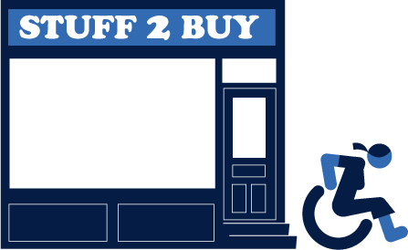
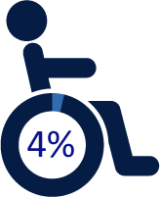
Business stats
The global disability market is larger than China and it should not be viewed as weak, but as a market that drives innovation in the face of seemingly insurmountable barriers Paul Polman Chair of Valuable 500 ¹
75% of disabled people and their families have walked away from a UK business because of poor accessibility or customer service (UK only). ³
$8 Trillion
The purple pound is worth 8 Trillion Dollars. This is the spending power of disabled people and their families. ²
£2 billion
a month
Only 4% of businesses are focused on making offerings inclusive of disability. ³
Businesses lose approximately £2 billion a month by ignoring the needs of disabled people. ⁴
People with disabilities say that 75% – 80% of their customer experiences are failures. ³
Notes:
https://www.independent.co.uk/independentpremium/voices/disability-business-government-b1765665.html
KPMG: https://assets.kpmg/content/dam/kpmg/uk/pdf/2018/05/leading-from-the-front-disability-and-the-role-of-the-board.pdf
https://www.thevaluable500.com
https://wearepurple.org.uk/the-purple-pound-infographic/

Slide 13
Barriers to life
VISUALLY IMPAIRED | HEARING IMPAIRED | PHYSICALLY IMPAIRED
Being out of home can be hard: collide with people, get lost, grabbed by strangers Not enough accessible information can make them feel cut off When shopping can struggle to find things Websites are often inaccessible App update-glitches can affect accessibility TV ads and programmes need good descriptions | Worry about meeting new people People often don’t know they have hearing impairments Can get verbal abuse Struggle in restaurants/ cinemas if no hearing loop Lose conversations if can’t see mouths Mask-wearing has made communication harder Need good subtitles to watch TV | In constant pain Lack of accessibility outside of home Access to public toilets Have to plan journeys to shop in advance Those in wheelchairs: people bump into them, hit them, can’t reach high
13

Slide 14
Barriers to purchase (disability business forum)
43% abandoning shopping tasks without purchasing. Of the 698 disabled consumers who participated in the research:
90% were affected at the decision-making stage of purchases by either; limitations of design, limitations in available information, or how information was presented.
65% agreed that ‘I feel like my choices of what to buy are limited on a daily basis due to barriers’.
27% disagreed with the statement that ‘I am able to request adjustments or identify my preferences or needs when I try to buy a product or service’.
Over half were likely to feel limited by choice, specifically because of their access needs, when booking holiday accommodation (59%) or in relation to leisure activities (56%).
Over 4 in 10 were limited to some extent when booking a new place to eat (45 per cent), finding a new provider – electricity, gas or broadband (40%) and opening or changing a personal bank account or renewing or changing insurance provider (40%).

Slide 15
Why it is important?
Is reflective of society
Might be your staff
Many who are not disabled will become a disabled
Creates brand warmth
You make better products
Stronger social currency
Can help you increase sales
Creates hope for people

Slide 16
Shift in approaches
The Old Approach
Fix the individual
Correct the deficit
Provide rehabilitation
People with disabilities are research subjects or patients
The New Approach
Remove the barriers
Access through accommodations and universal design
Opportunities and education for a range of activities
Patrons of disabilities get involved as community members, advisors
16

Slide 17
3. Neurodivergents

Slide 18
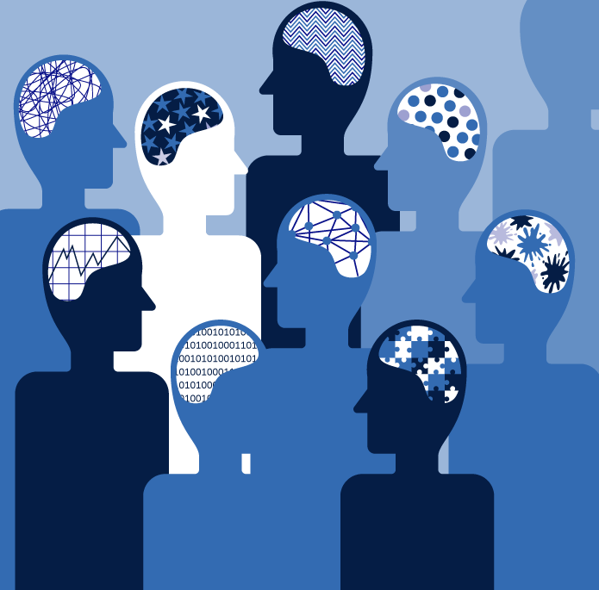
Definition
What does neurodivergent mean?
Neurodivergent refers to the idea that neurological differences, such as those seen in autism or ADHD, reflect normal variations in brain development. (Psychology Today)
18

Slide 19
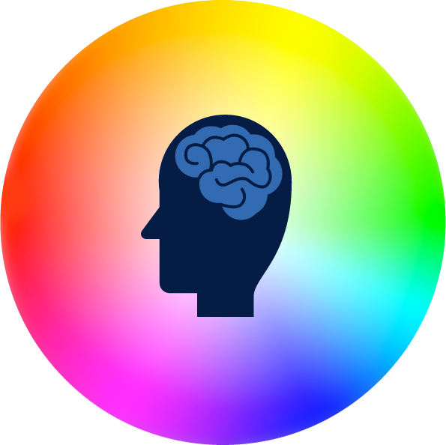
Conditions
Autism
Tourette’s & Tic disorders
ADHD
Dyscalculia
Intellectual Disability
Neurodivergent
Dyslexia
Foetal Alcohol Spectrum Disorder
Epilepsy
Development of Language Disorder
19

Slide 20
Conversations around the neurodivergent
There is a lot of debate within the community about whether being neurodivergent is a disability
There’s a lot of debate and it’s also very much down to the individual. I saw a post this morning and it said, “Autism is not a different ability, it’s a disability.” I saw someone the other day who’s dyslexic and someone was talking about dyslexia being a disability, he said, “What the hell!? I’m dyslexic and in no way do I feel disabled at all, I feel like I’ve got a super-power...” So it’s very much an individual thing. (Neurodivergent, UK)
‘Neurodiverse’ has different connotations to ‘neurodivergent’
Language is really important; if you use language like ‘neurodiversity’, you might get a back-lash because people don’t have ‘neurodiversity’, the term ‘neurodiversity’ is meant to mean everybody. (Neurodivergent, UK)
20

Slide 21
Myths (1/3)
Neurodivergence only refers to autism
While the term was originally coined by an autistic sociologist, as time passed, the neurodiversity movement expanded. Neurodiversity in itself is the diversity of all brains and all minds. Neurodivergence can therefore be associated with things like ADHD, epilepsy, etc.. (Neurodivergent Advocate)
Neurodivergent individuals are all alike
There is a common saying that goes, “If you’ve met one person with autism, you’ve met one person with autism.” Just as neurotypical people are different, so are neurodivergent individuals. Autism in particular isn’t a single disorder but a spectrum of related disorders that share many core symptoms. Each person is unique in regards to their level of disability and their combination of symptoms. (Neurodivergent Advocate)
They cannot or do not want to form relationships
Neurodivergent individuals can and do have fulfilling relationships with family and friends. A lot of the time their social interactions may be impaired as people with ASD typically have problems with social interactions and people with depression and anxiety tend to withdraw themselves. This tends to make things worse for them as most of them really do want to form relationships with others but end up feeling depressed or isolated when they are unable to connect with others. People with ASD typically have a hard time navigating social relationships, understanding social cues and even being too blunt at times. Genuine, long-lasting relationships are possible between NDs and NTs especially if they are both accepting and aware of their differences. (Neurodivergent Advocate)
21

Slide 22
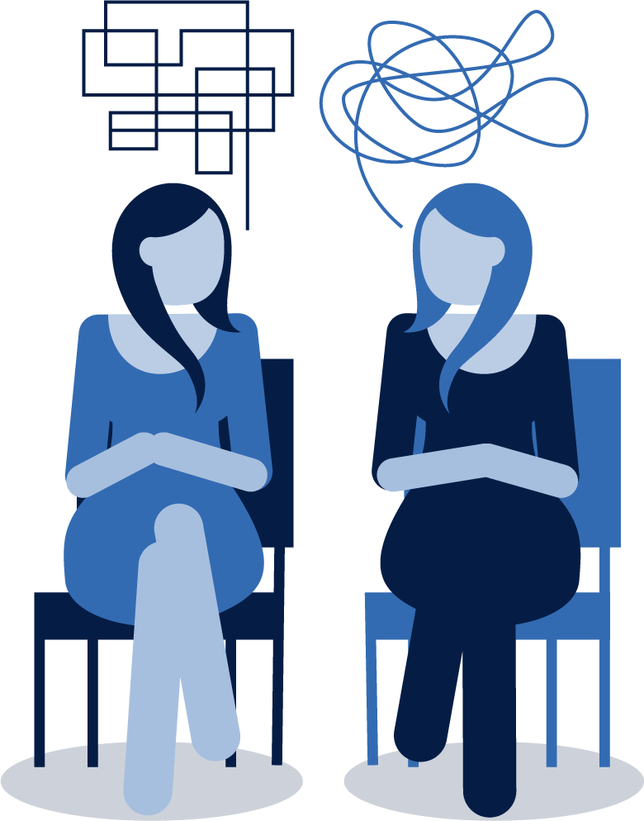
Myths (2/3)
Don’t have empathy
One researcher once said, “Autistic people don’t have empathy”, but autistic people say, “Neurotypical people don’t have empathy then if they don’t have empathy for us!”, so there’s this whole ‘Double Empathy theory’. (Neurodivergent, UK)
Neurodivergent people have intellectual disabilities
Just like some neurotypical individuals, some NDs also have an intellectual disability but that is not the case with all of them. In fact, many neurodivergent individuals have an intelligence quotient (IQ) within the typical range or higher. Autism often coincides with exceptional abilities in some areas such as maths, music, writing or art. (Neurodivergent, UK)
They have little chance of being successful
ND individuals can achieve great things. They may see the world, typically set up for NTs, from a different perspective but that does not mean that they can’t be successful. Many NDs are more creative, observant, detail-oriented, and focused. A lot of them can absorb and retain facts better as their long-term memory can be excellent. (Neurodivergent, UK)
22

Slide 23
Myths (3/3)
They lack communication skills
Many ND individuals often lack the necessary social skills to be successful during job interviews and in the workplace. They also often may have a preferred way of communicating. Some individuals with autism spectrum disorder may be nonverbal or have trouble with verbal communication which can be due to anxiety or just needing more time to process the information that they receive verbally. (Neurodivergent Advocate)
They are abnormal
They might be living in their own world. For example, when they are in a group activity, they might suddenly make inappropriate behaviour such as talking really loud or making inappropriate gestures at the event. Unless you are a professional in this field, otherwise you may definitely sense this person is abnormal. (Neurodivergent Advocate)
23

Slide 24
Some specific myths for different conditions
People with dyslexia are stupid
People might think they’re ‘stupid’, ‘they’re thick’, because they can’t spell. (Neurodivergent Advocate)
People with ADHD are lazy
They’re ‘lazy’, they’re ‘flaky’, they’re ‘inconsistent’, they ‘don’t turn up’, they’re ‘not going to be committed’ – which is bullshit as well, it’s just that they’re struggling! (Neurodivergent Advocate)
People with autism are geeks
They’re into maths, or they’re ‘geeks’, or they’re ‘anti-social’, they’re ‘quiet’, they’re ‘weird’, they’re ‘obsessive’. (Neurodivergent Advocate)
People with dyspraxia are clumsy
24

Slide 25
ADHD: How it impacts on lives (1/3)
Might not be able to concentrate if they have ADHD
ADHD lacks the ability to focus, this may affect their learning ability. They cannot pay attention to things. That’s something they cannot control themselves. (Neurodivergent Advocate)
With ADHD they will be moving around quite a lot
ADHD is their lack of the ability to focus. You will see them move around quite frequently, for a moment he or she may be here working on something, and the next moment they will be somewhere else, playing Lego, for example. (Neurodivergent Advocate)
Time structure
People with ADHD are time-blind, people work to different rhythms, people do not switch their brain on from 9 to 5, some people might want to work at 3am. (Neurodivergent Advocate)
Memory can be difficult
Memory is a difficult thing – for example, if I have a meeting, I have to record it on my dictaphone and make sure I take notes, but I won’t remember everything and people expect you to remember everything, and you sometimes you need it written up afterwards. (Neurodivergent Advocate)
25

Slide 26
Autism: How it impacts on lives (2/3)
Might not be able to follow orders
Autism patients, may not obey your order. (Neurodivergent Advocate)
Might dislike crowds
Autistic employees may have problems in working with a lot of people. (Neurodivergent Advocate)
It also may be a person who has challenges in moving around the city in the big crowds of people. (Neurodivergent Advocate)
Can sometimes lack social abilities
Their main challenge is that they will lack social ability. Or sometimes they can just focus on one thing, like spinning a ball for a whole day, without communicating with anyone else. (Neurodivergent Advocate)
26

Slide 27
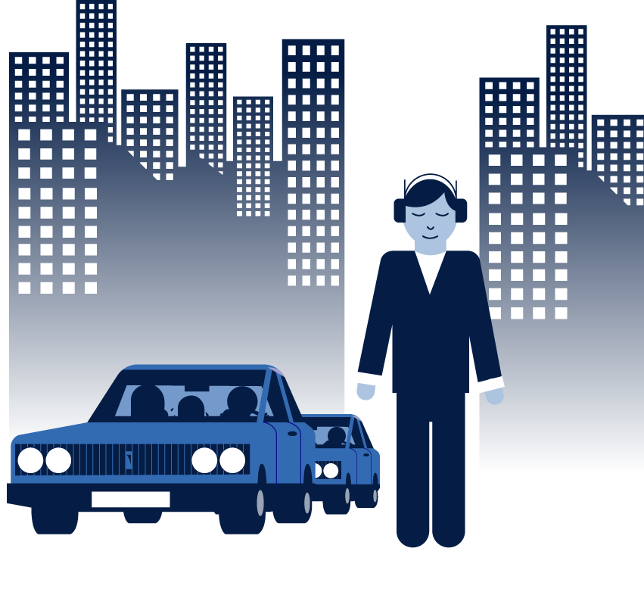
Autism: How it impacts on lives (3/3)
Can be sensory sensitive
The people of the autism spectrum are sensory sensitive. Autism's sensory issues can involve both hyper-sensitivities and hypo-sensitivities so they can be very sensitive to specific stimuli and not enough sensitive to others. It can make a range of problems from what food they can eat because they can become nervous of some consistency… I mean emotionally annoyed. They just feel bad. They won’t eat specific food or wear specific clothing because it basically hurts or makes them feel uncomfortable. It includes light, sounds, and huge crowds of people, loud sounds or the specific types of sound. (Neurodivergent Advocate)
If they’re autistic adults, many of them prefer wearing headphones. They use the means of protection from the aggressive sound environment of the city. (Neurodivergent Advocate)
If you’re autistic or have ADHD, you have no filter, you have the sensory differences, so you can’t concentrate because of the noise. (Neurodivergent Advocate)
If you’re autistic, lights could be giving you headaches, and all the people around you, and the feelings and all the vibes can literally make you have a meltdown. (Neurodivergent Advocate)
27

Slide 28
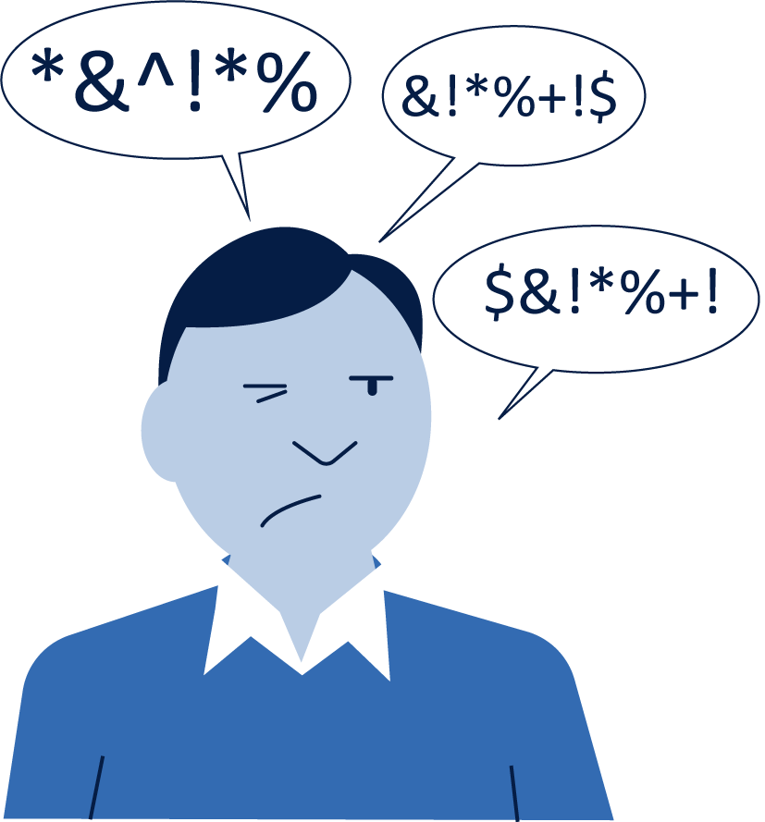
Some other conditions: How they impact on lives
Tourette’s: Can make noises
Tourette Syndrome, some of them are quite ill, they will be making odd noise with their body quite often, clearing their throats every few seconds, and that could end up at home laying in bed because he or she will be making that noise every few seconds. (Neurodivergent Advocate)
Williams Syndrome: Very sociable
Williams Syndrome are very, very sociable, it’s the total opposite to autistic people. (Neurodivergent Advocate)
Can have learning difficulties
She can’t focus, so she doesn’t want to do it. She has to learn how to follow instructions, so that’s a good thing but the challenge is that going through the process is quite a pain. (Neurodivergent Advocate)
Don’t like loud noises: Williams Syndrome
Autistic are sensitive to very loud noises, when they grow older they don’t mind it but when they’re younger they will cover their ears whenever there’s a storm, their ears are sensitive. (Neurodivergent Advocate)
28

Slide 29
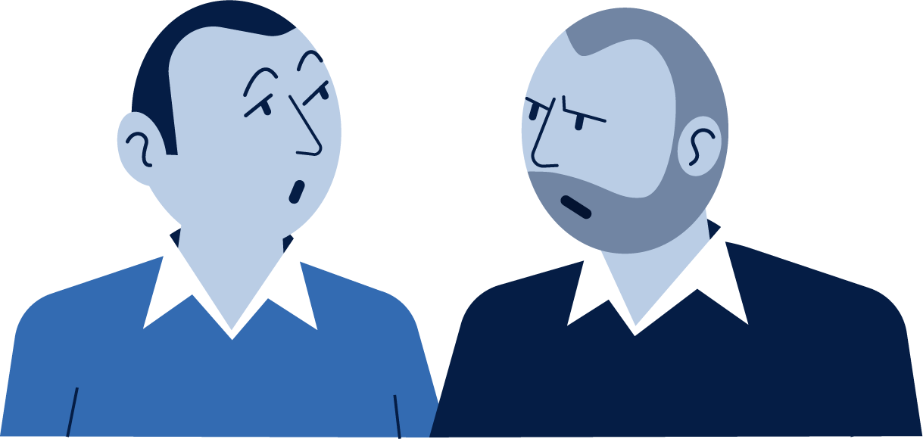
Hurdles: Relationships
Neurodivergents can find it hard to have relationships
It’s very difficult to be friends with someone if they don’t understand ADHD and autism because autistic people can appear to be really rude and direct and just say what they think and not really think before they speak, there’s no filter, so that can really upset people. People really need to understand that these people don’t really mean it and to just give them a chance, rather than to judge. (Neurodivergent Advocate)
29

Slide 30
Hurdles: Shopping
Can need to plan things in advance
That’s why many autistic people plan their routes in advance, avoiding the specific places. (Neurodivergent Advocate)
Familiarity can be very important for autism
If there are the adult autistic people who go to the grocery stores and they’re very independent because autism is the spectrum, so usually a person, what he or she eats, and sometimes they eat the same for years. So they often go and buy those products which they know are familiar. (Neurodivergent Advocate)
Familiarity is important to autistic people. (Neurodivergent Advocate)
Can become fixated on one thing in store
They might not be interested in the variety of things at the store, but they might be just into one thing. For example, some may be interested in plastic bottles, and that will be the only thing they pay attention to in a store. (Neurodivergent Advocate)
People with ADHD can like novelty and familiarity combined
People with ADHD like novelty, they like new things but then they like the familiarity – so they like limited editions, so it’s a bit different for a little while and then you change it back, like for Christmas, something that’s a bit unusual but then you change it back again, that could work quite well because it’s novel at different times of the year. (Neurodivergent Advocate)
30

Slide 31
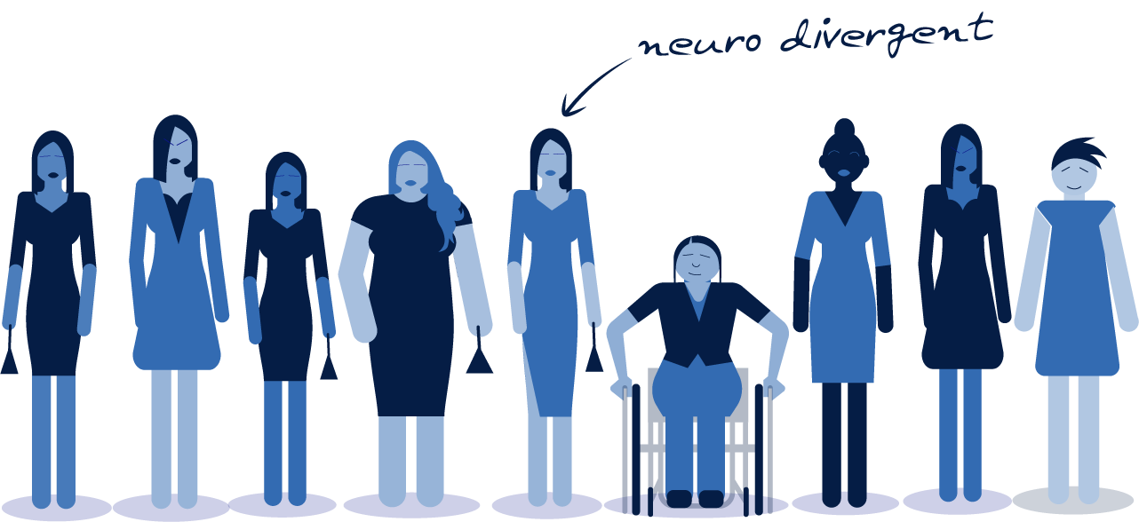
What we found in Femcare
31

Slide 32
4. Representation: Disability and neurodiversity

Slide 33
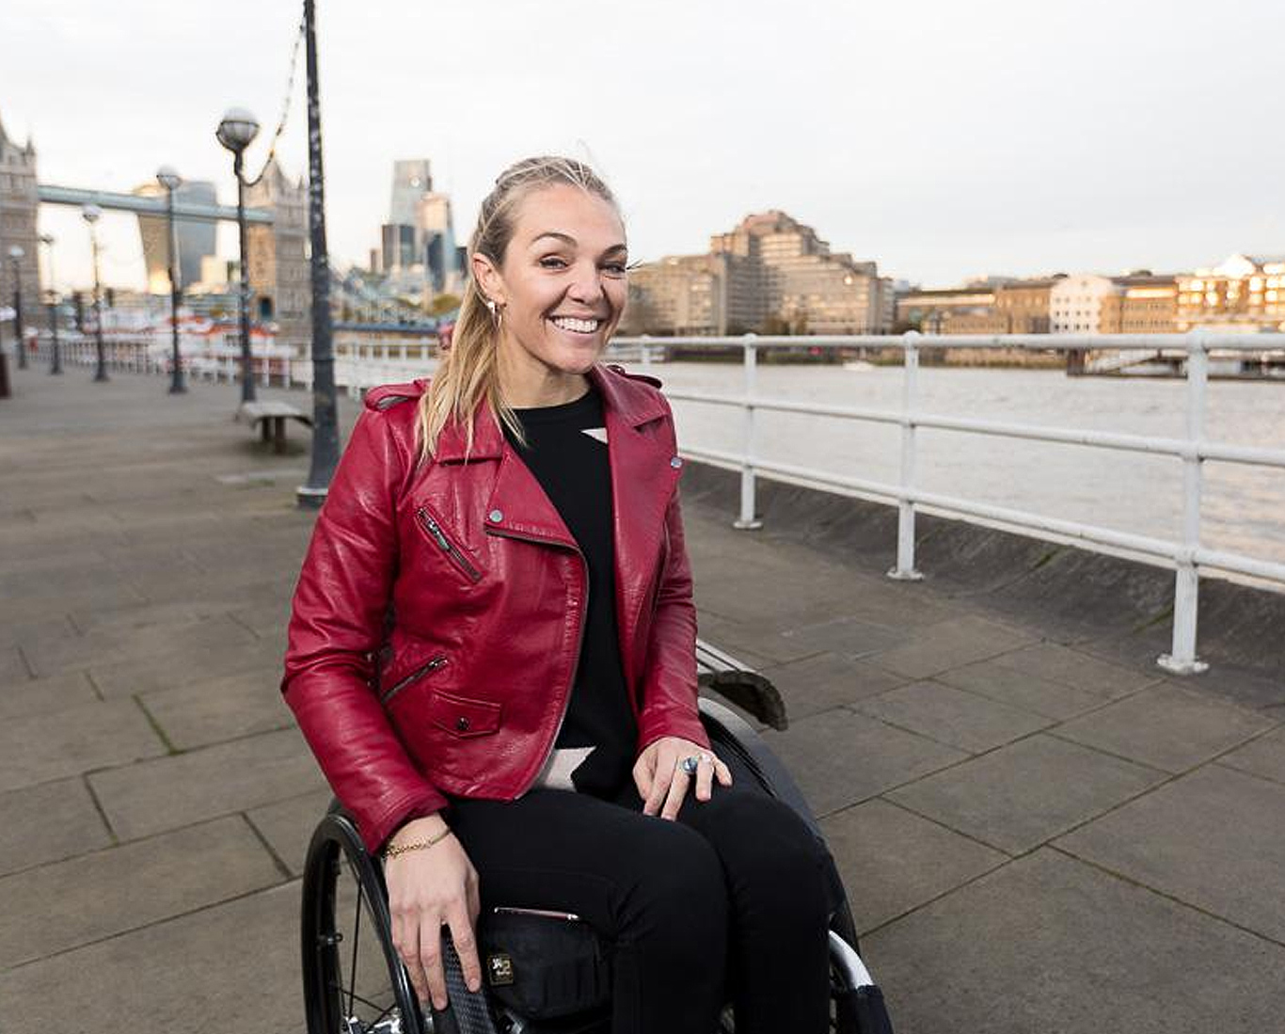
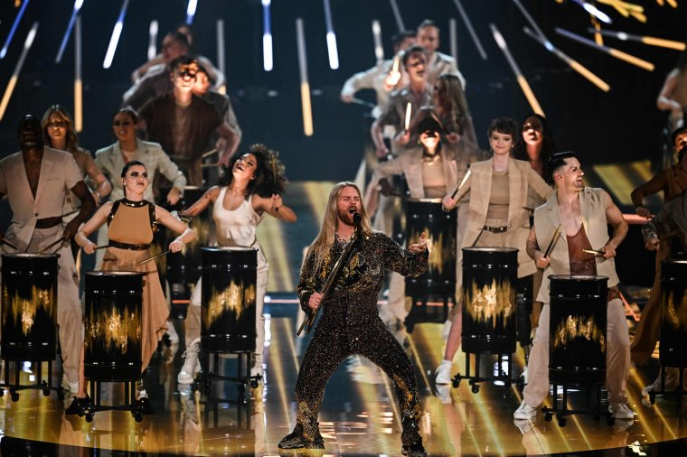
Representation has improved…
33

Slide 34
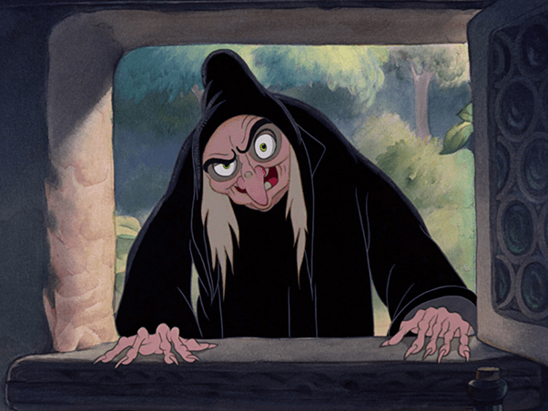
… but often are seen as villains
34

Slide 35
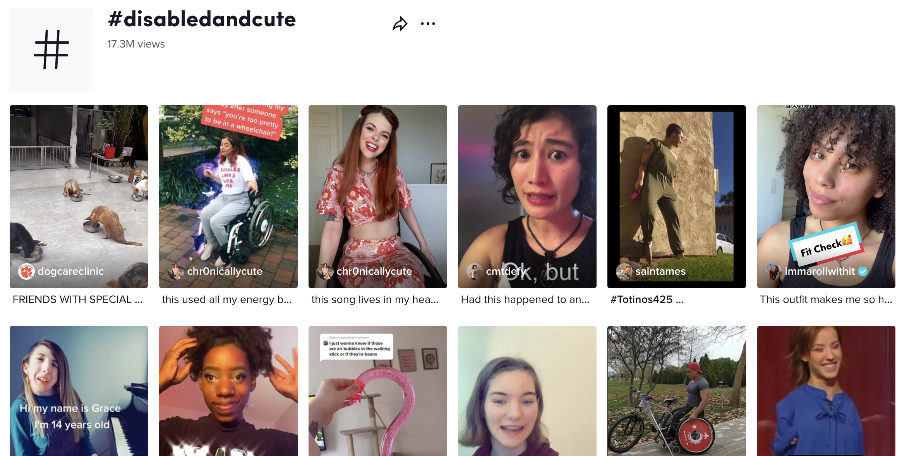
Social media
Social media has improved disabled voices
Tik Tok is game changer
Content has shifted from disability content to passion points
Algorithms can mean content does not always get through
Some content can be stuck in an echo chamber
AR/VR will be a gamechanger
35

Slide 36
5. Communications: General rules

Slide 37
Don’t create new stereotypes
Lesbians
Butch
Super pretty
Bigger Bodies
Sad
Happy
Trans
Horror
Fragile
Neurodiverse
Idiot
Genius
Physical Disability
Struggling
Superhuman
Ethnic Minority
‘Ghetto’
Businessmen
Muslim
‘Fundamental’
Liberal
37

Slide 38
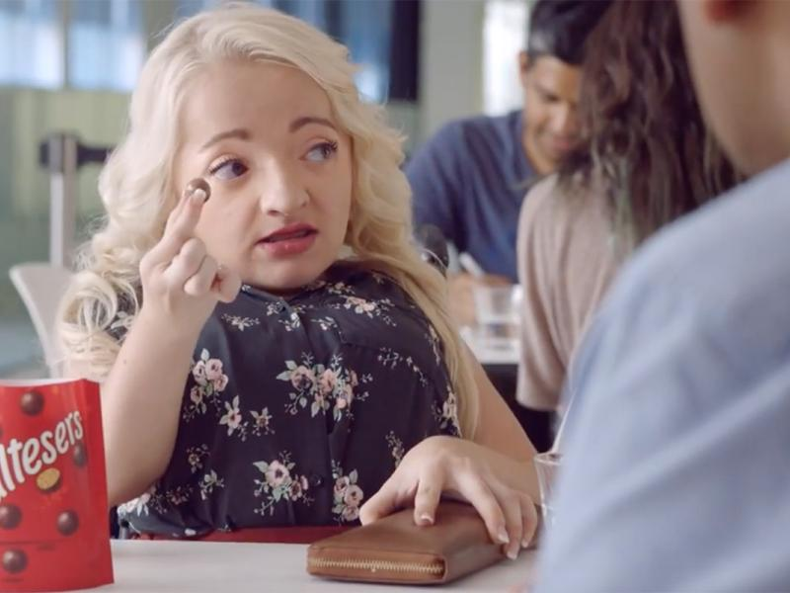
Be true to your tone
38

Slide 39
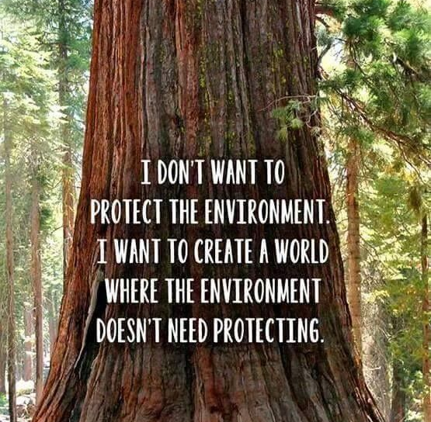
Look for what unites us
Unity: People coming together
Decency: Being kind to people and the environment
Protection: Looking after physical and mental health and economic well-being of me and my family
Fun: Not taking life too seriously
Honesty: More straight-talking and honesty
Fairness: Making the unfair fair
39

Slide 40
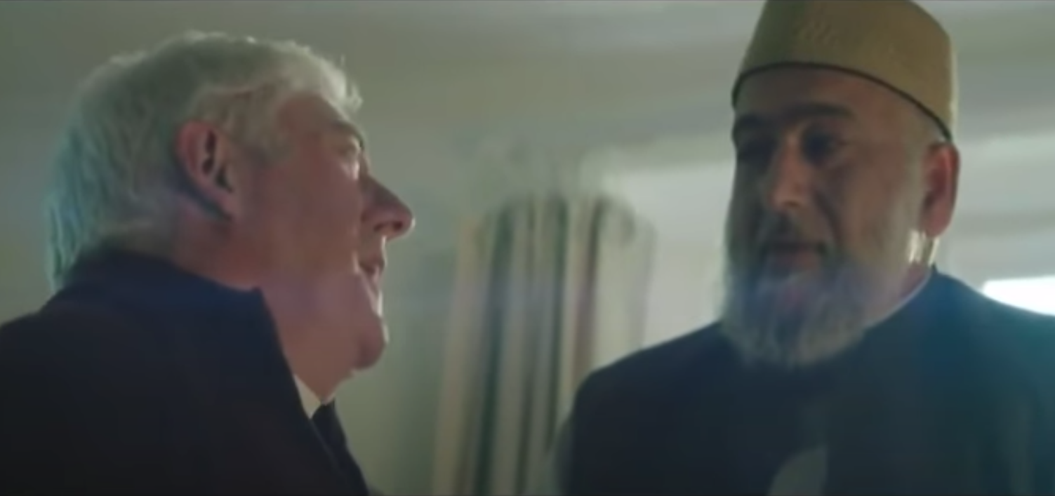
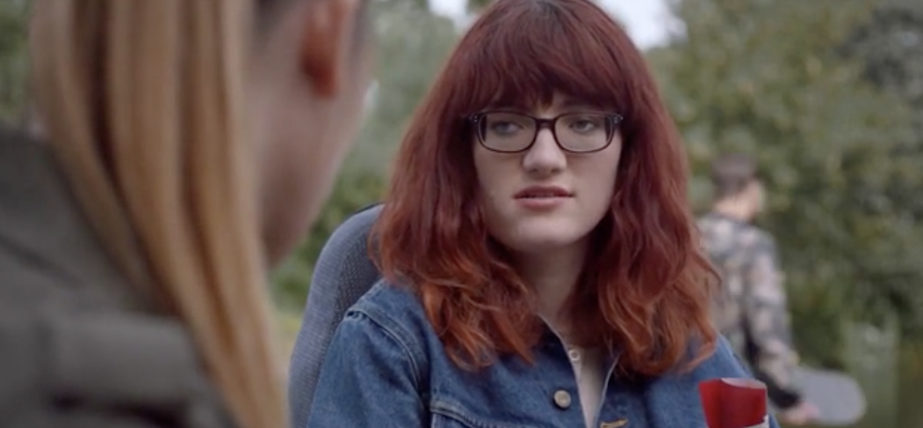
Best communications tap into shared values
Amazon: Priest and Iman
Maltesers: Disability
Virgin: Disability
40

Slide 41
5. Communicating Disability

Slide 42
If you can challenge stereotypes
GENERAL MYTHS | VISUALLY IMPAIRED | HEARING IMPAIRED | PHYSICALLY IMPAIRED
All disabled people are the same Are a burden on society Should be pitied Should be treated like children Can’t be wife, mother, have sex, feel pleasure Can’t be successful | See only total darkness All use Braille Are old people Can’t be fashionable. Can’t be independent Can’t have dreams (literal) Can’t enjoy TV content | Stupid Incapable Mad Ignorant Must be treated delicately Hearing aids are always ugly | Stupid/have learning difficulties Been in an accident Incapable of conversation
42

Slide 43
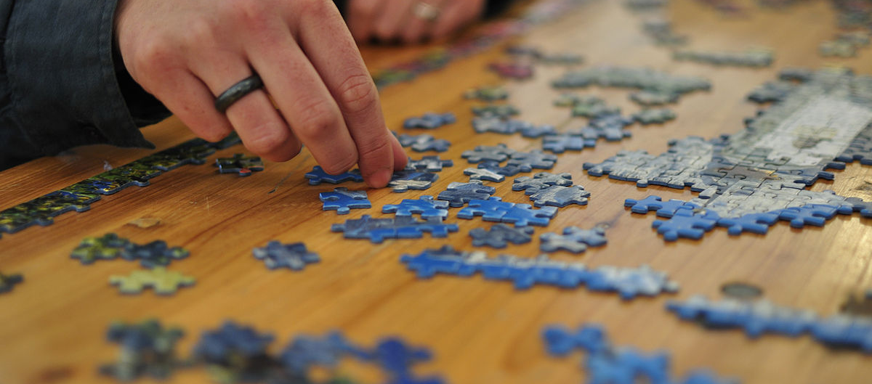
If you can show as much of the full jigsaw as possible
43

Slide 44
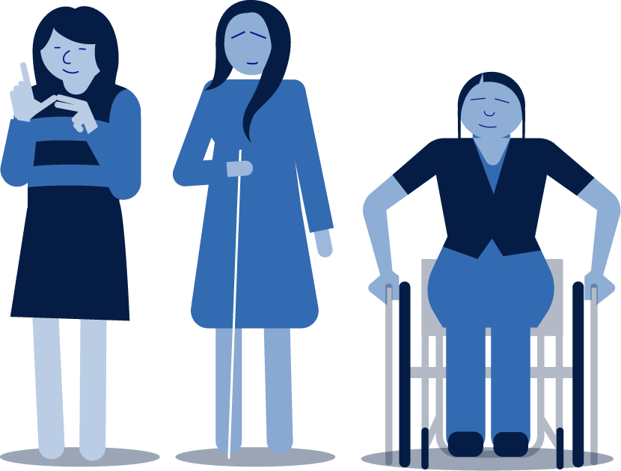
Some additional thoughts
Perhaps go beyond the wheelchair
Don’t be too activist
Don’t shout disabled
Don’t go too inspiration
Be like Shrek
Think beyond the obvious eg. Hidden disabilities, multiple disabilities, intersectionality
Use disabled people behind the camera
Maybe think about 1 in 5
Use facts that jolt
Don’t die by consensus
Enhance the power of those out there
Think about right media – utilise it
Make sure you research with the right people
Have conversations
Challenge your thinking
If you have agencies challenge them
Be prepared to be criticised
44

Slide 45
6. Researching disability

Slide 46
Some thoughts on research
Have people with disabilities on multiple projects
Disability and neurodiversity are not homogenous
Interview the person not the disability
When booking a facility to conduct in-person research, carefully verify their accessibility. People mean well, but often don't know if their facility is fully accessible. Check:
Will the room and hallways accommodate wheelchairs?
Are there automatic doors and elevators, and are they easily accessible?
Will the bathroom accommodate a wheelchair, and can they get to it?
Are the tables high enough? Are they height adjustable?
Where are the nearest public transit stops and parking spots for people with disabilities?
Because it will be more difficult for someone with a disability to come to you, expect to pay a higher incentive.
Have regular breaks
Allow a carer to come or sign interpreter if needed
Send questions in advance
Think about stimulus
Research methods and practices should be accessible to people with disabilities online. An excellent place to start is by asking research platform providers if they are WCAG 2.0 or 2.1 compliant.
46

Slide 47
7. Innovation

Slide 48
Some thoughts on innovation
Natural hackers
Get multiple perspectives
Use Quant to identify gaps
Have a small core team
Really understand your audience at both cultural and behavioural level
Get close to the lived experience
Utilise the power of the crowd: Co-create
Don’t steal and leave
Have co-creators for the project duration
Make it iterative
Use film
Have experts in room
Decide whether you want universal design
Pay well and also donate to charity
48

Slide 49
Contact: steve@outsidersinsight.com
Steven Lacey
www.outsidersinsight.com
49

